Slide 1



Flight Delay Analysis
Project 1 - KU Data Analytics Bootcamp
Presented by:
Peiwen Chiu
Jen Zapata
Heidi Fox

Slide 2
01
Project Selection / Background
What
Why
How
CONTENTS
02
Analyzed
On-Time Performance
Delay Patterns
Airport and Route Impact
03
On-Time Performance
04
Delay Patterns
05
Airport and Route Impacted

Slide 3
What – Why - How
This team chose to analyze flight delays over the past 5 years (2019 – May 2024). We narrowed our data to include only four of the main domestic airlines: American, Delta, United, and Southwest. We examine the delay reason by using the five categories provided in the dataset obtained by kaggle ; carrier delay, weather delay, aviation delay, security delay, or late aircraft.
This topic was selected because the we were curious
about flight delays and how flight delays have been
trending over the past 5 years.
We collected the dataset from U.S. Bureau of Transportation Statistics (BTS) as a csv file. We wrote and executed Python script in Jupyter Notebook to explore the data. We included Matplotlib for data visualization.
Flight delay categories:
Carrier Delay (carrier_ct): Delays caused by the airline itself, such as issues with crew, maintenance, or aircraft cleaning.
Weather Delay (weather_ct): Delays caused by weather conditions that make flying unsafe or impossible.
National Aviation System Delay (nas_ct): Delays related to air traffic control, airport operations, heavy traffic volume, or other reasons that
are part of the national aviation system.
Security Delay (security_ct): Delays caused by security-related issues such as security breaches or heightened security measures.
Late Aircraft Delay (late_aircraft_ct): Delays caused by a previous flight arriving late (can be combination of reasons), which impacts the
departure of the subsequent flight.

Slide 4
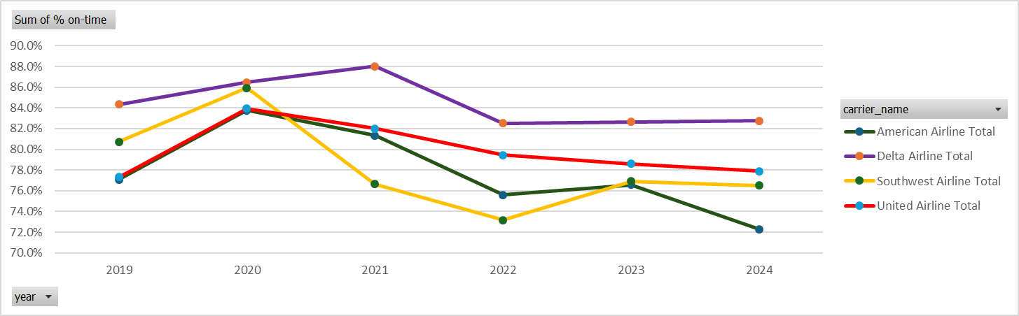
On-Time Flights
On-time flights increased during 2020 and into 2021
This is the result of a reduction in flights during COVID. A reduction in the amount of flights will minimize airport traffic while going through security and processing at the gate. It will also reduce the amount of air traffic.

Slide 5
Delay Patterns
Replace with your own text

Slide 6
Airports & Routes Impacted
Replace with your own text

Slide 7
Do you have any questions?
THANK YOU!

